Slide 1
Theory of Production and Cost
Chathuranga Adhikari
B.com (Sp)(Hons), M.com

Slide 2
Theory of the Firm: Production & Cost
A business firm is an organization, owned and operated by private individuals, that specializes in production.
Production is the process of combining inputs to make outputs.
The firm buys inputs from households or other firms and sells its output to consumers.
Profit of the firm = Sales revenue – Input costs

Slide 3
The Nature of the Firm
Every firm must deal with the government
  Pays taxes to the government
  Must obey government laws and regulations
  Receive valuable services from the government
      Public capital
      Legal systems
      Financial systems

Slide 4
The Firm and Its Environment
Owners
Initial Financing
Profit After Taxes
Input Costs
Taxes
Input Suppliers
The Firm (Management)
Government
Inputs
Government Services Government Regulations
Output
Revenue
Customers

Slide 5
Production
Production involves using inputs to produce an output
Inputs include resources
  Labor
  Capital
  Land
  Raw materials
  Other goods and services provided by other firms
The way in which these inputs may be combined to produce output is the firm’s technology

Slide 6
Production
Production means transforming inputs (labor, machines, raw materials, etc.) into output.
The production process does not necessarily involve the physical conversion of raw materials into tangible goods; it also includes the conversion of intangible inputs to intangible outputs. Ex., layer, doctors, social workers, etc.
An input is good or service that goes into the process of production and output is any good or service that comes out of production process.

Slide 7
Production Technology
A firm’s technology is treated as a given
  Constraint on its production, which is spelled out by the firm’s production function
  For each different combination of inputs, the production function tells us the maximum quantity of output a firm can produce over some period of time

Slide 8
The Firm’s Production Function
Alternative Input Combinations
Production Function
Different Quantities of Output

Slide 9
The Short Run and the Long Run
Useful to categorize firms’ decisions into
    Long-run decisions
    Short-run decisions
To guide the firm over the next several years
  The manager must use the long-run lens
To determine what the firm should do next week
  The short-run lens is best

Slide 10
Short Run Production
It refers to a period of time in which the supply of certain inputs (e.g., plant, building, machines, etc) is fixed or inelastic.
Thus, increasing production during this period is possible only by increasing the variable input.

Slide 11

Production in the Short Run
When firms make short-run decisions, there is nothing they can do about their fixed inputs
Fixed inputs
  An input whose quantity must remain constant, regardless of how much output is produced
Variable input
  An input whose usage can change as the level of output changes
Total product
  The maximum quantity of output that can be produced from a given combination of inputs

Slide 12
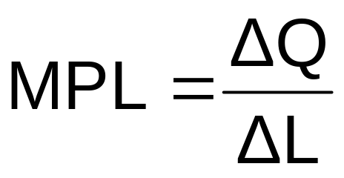
Production in the Short Run
The marginal product of labor (MPL) is the change in the total product (ΔQ) divided by the change in the number of workers hired (ΔL)
  Tells us the rise in output produced when one more worker is hired, leaving all other inputs unchanged

Slide 13

Total Product and Marginal Product
Units of Output
196
Total Product
184
161
ΔQ from hiring fourth worker
130
ΔQ from hiring third worker
90
ΔQ from hiring second worker
30
ΔQ from hiring first worker
1
2
3
4
5
6
Number of Workers
increasing marginal returns
diminishing marginal returns

Slide 14

Marginal Returns To Labor
As more and more workers are hired
    MPL first increases
    Then decreases
The pattern is believed to be typical at many types of firms

Slide 15
Increasing Marginal Returns to Labor
When the marginal product of labor increases as employment rises, we say there are increasing marginal returns to labor
  Each time a worker is hired, total output rises by more than it did when the previous worker was hired

Slide 16
Diminishing Returns To Labor
When the marginal product of labor is decreasing
  There are diminishing marginal returns to labor
  Output rises when another worker is added so the marginal product is positive
  But the rise in output is smaller and smaller with each successive worker
The law of diminishing (marginal) returns states that as we continue to add more of any one input (holding the other inputs constant)
  Its marginal product will eventually decline

Slide 17
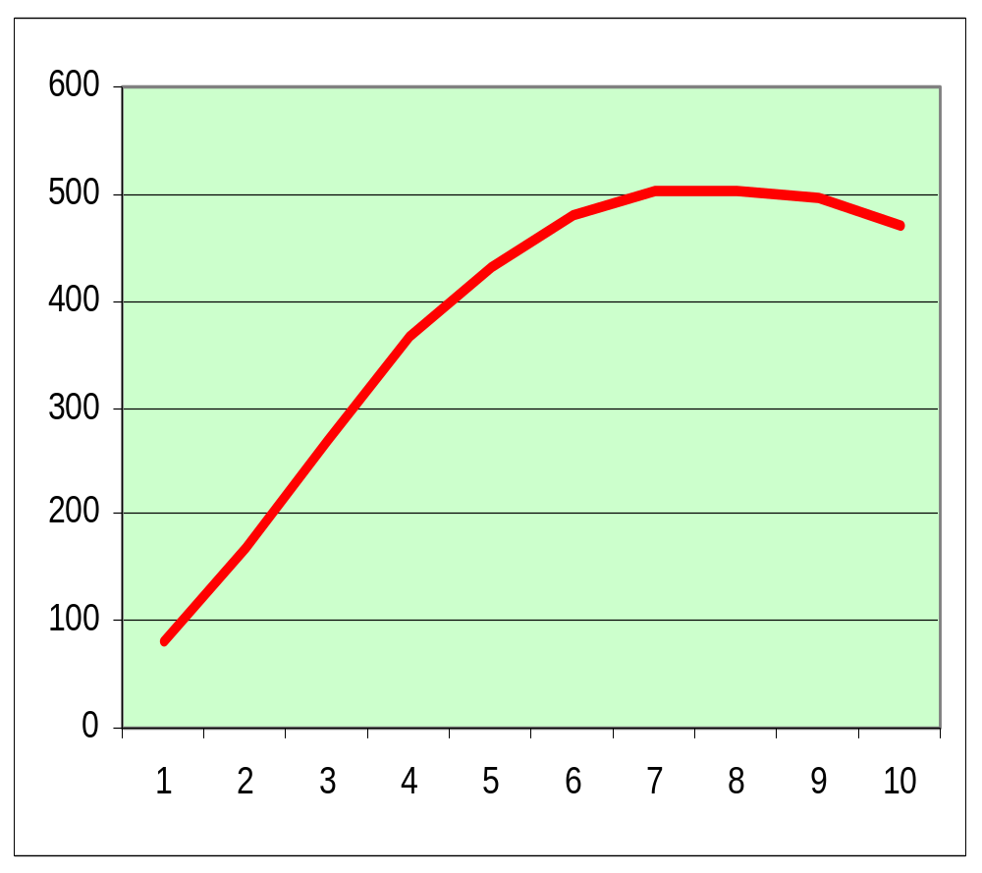
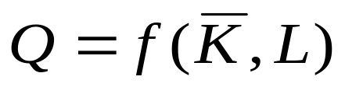
L | Q | MP | AP
1 | 80
2 | 170
3 | 270
4 | 368
5 | 430
6 | 480
7 | 504
8 | 504
9 | 495
10 | 470

Slide 18
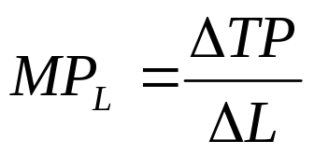
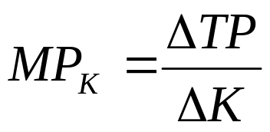
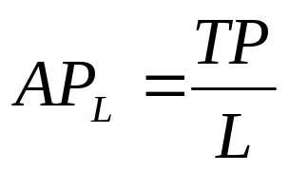
L | Q | MP | AP
1 | 80 | 80 | 80
2 | 170 | 90 | 85
3 | 270 | 100 | 90
4 | 368 | 98 | 92
5 | 430 | 62 | 86
6 | 480 | 50 | 80
7 | 504 | 24 | 72
8 | 504 | 0 | 63
9 | 495 | -9 | 55
10 | 470 | -25 | 47

Slide 19
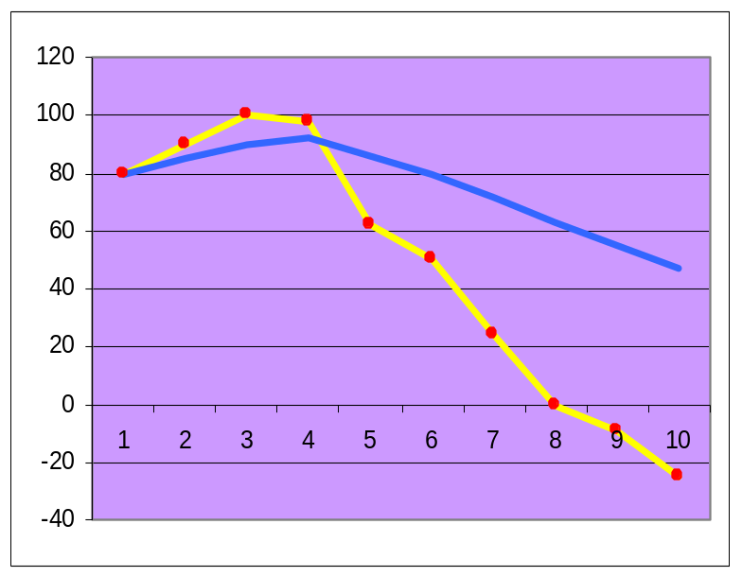
L | Q | MP | AP
1 | 80 | 80 | 80
2 | 170 | 90 | 85
3 | 270 | 100 | 90
4 | 368 | 98 | 92
5 | 430 | 62 | 86
6 | 480 | 50 | 80
7 | 504 | 24 | 72
8 | 504 | 0 | 63
9 | 495 | -9 | 55
10 | 470 | -25 | 47

Slide 20
L | Q | MP | AP
1 | 80 | 80 | 80
2 | 170 | 90 | 85
3 | 270 | 100 | 90
4 | 368 | 98 | 92
5 | 430 | 62 | 86
6 | 480 | 50 | 80
7 | 504 | 24 | 72
8 | 504 | 0 | 63
9 | 495 | -9 | 55
10 | 470 | -25 | 47

Slide 21
Short term production function
L | Q | MP | AP
1 | 80 | 80 | 80
2 | 170 | 90 | 85
3 | 270 | 100 | 90
4 | 368 | 98 | 92
5 | 430 | 62 | 86
6 | 480 | 50 | 80
7 | 504 | 24 | 72
8 | 504 | 0 | 63
9 | 495 | -9 | 55
10 | 470 | -25 | 47
1
2
3
1 Increasing marginal productivity zone
2 Diminishing marginal productivity zone
3 Negative marginal productivity zone

Slide 22
Exercise
No. of Workers | Total Product (TP) | Average Product (AP) | Marginal Product (MP)
1 | 10
2 | 22
3 | 36
4 | 52
5 | 66
6 | 76
7 | 82
8 | 85
9 | 85
10 | 83

Slide 23
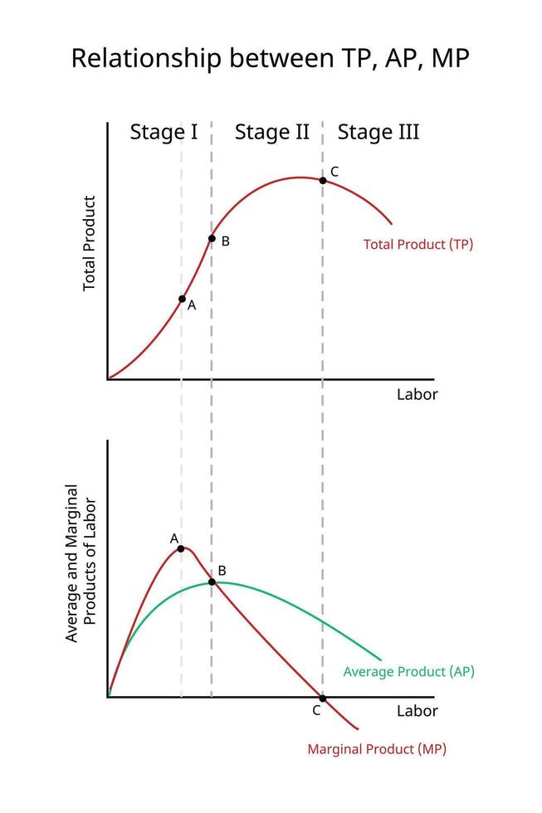
When AP is maximum, MP= AP
When TP is maximum, MP= 0
When TP is falling, MP is negative
As long as TP is positive, AP is positive
AP and MP are inverted U-shaped curve
MP cuts AP at its maximum point and at that point, MP=AP

Slide 24

Long Run Production
It refers to a period of time in which the supply of all the input is elastic, but not enough to permit a change in technology.
In the long run, the availability of even fixed factors increases.
Thus, in the long run, the production of commodities can be increased by employing more of both, variable and fixed inputs.

Slide 25

Costs
A firm’s total cost of producing a given level of output is the opportunity cost of the owners
  Everything they must give up in order to produce that amount of output

Slide 26

The Irrelevance of Sunk Costs
Sunk cost is one that already has been paid, or must be paid, regardless of any future action being considered
Should not be considered when making decisions
Even a future payment can be sunk
  If an unavoidable commitment to pay it has already been made

Slide 27

Explicit vs. Implicit Costs
Types of costs
    Explicit (involving actual payments)
    Money actually paid out for the use of inputs
    Implicit (no money changes hands)
    The cost of inputs for which there is no direct money payment

Slide 28
Economic vs. Accounting Costs
  Economic costs are theoretical constructs that are intended to aid in rational decision-making.
  Accounting costs are legal constructs intended to provide uniformity in measurement.

Slide 29

Profit
Profit = Total Revenue – Total Costs
Total Net Benefits = Total Benefits minus Total Costs
Costs as Opportunity Costs
    Explicit Costs
    Implicit Costs
    The opportunity cost of entrepreneur’s invested capital
    The opportunity cost of the entrepreneur’s time

Slide 30
Economic versus Accounting Profit
How an Economist
How an Accountant
Views a Firm
Views a Firm
Economic
profit
Accounting
profit
Implicit
Revenue
costs
Revenue
Total
opportunity
costs
Explicit
Explicit
costs
costs
Copyright © 2004 South-Western

Slide 31
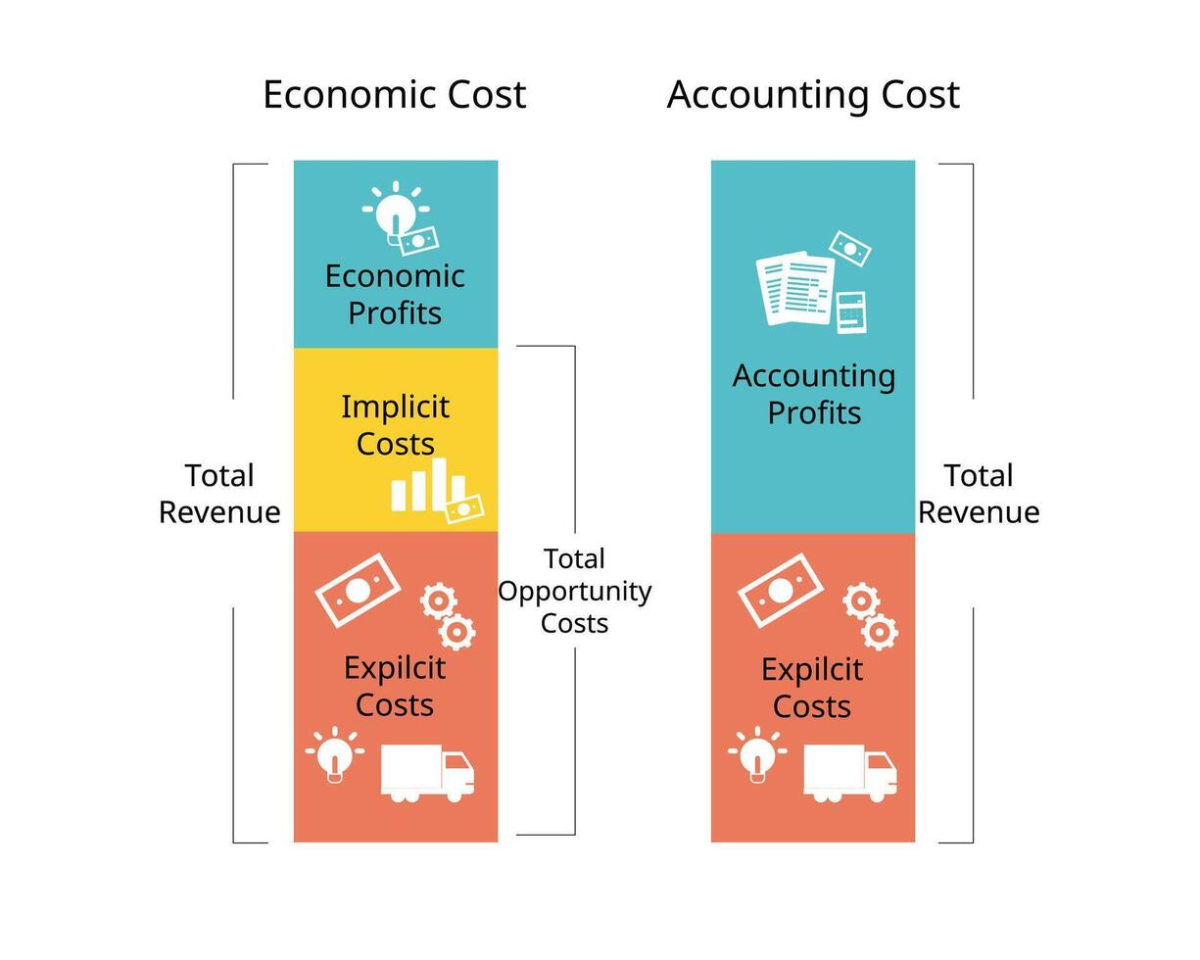
Economic vs. Accounting Profit

Slide 32
Economic vs. Accounting profit
Economic profit = Total revenue - All economic costs
Accounting profit = Total revenue - All accounting costs
Accounting costs include only current or historical explicit costs, not implicit costs

Slide 33
Economic vs. Accounting profit
The difference between economic cost and accounting cost is the opportunity cost of resources supplied by the firm’s owner.
The opportunity cost of these owner-supplied resources is called normal profit.
Normal profit is the cost of production.

Slide 34
Economic vs. Accounting profit
If a firm is receiving economic losses (negative economic profits), the owners are receiving less income than could be received if their resources were employed in an alternative use.
In the long run, we'd expect to see firms leave the industry when this occurs.

Slide 35
Economic profit
Economic profit = Total Revenue - Economic Costs
When output rises, both total revenue and total costs increase
Profits increase when output increases if total revenue rises by more than total costs.
Profits decrease when output rises if total costs rise by more than total revenue

Slide 36
Costs in the Short Run
Fixed costs
Costs of a firm’s fixed inputs
Variable costs
Costs of obtaining the firm’s variable inputs

Slide 37
Fixed Cost
Fixed costs are those costs that do not vary with the volume of production.
Even if the production is zero, a firm will have to incur fixed costs.
Examples are rent, interest, depreciation, insurance, salaries, etc.
It is also called supplementary costs, capacity costs, period costs, or overhead costs.

Slide 38
Variable Cost
Variable costs are those costs that change with the quantity of production.
When the output increases, the variable cost also increases, and when the output decreases, the variable cost also decreases.
Examples are materials, wages, power, stores, etc.
Variable costs are also known as prime costs or direct costs.

Slide 39
Measuring Short-Run Costs: Total Costs
Types of total costs
    Fixed costs
    Cost of all inputs that are fixed in the short run
    Total variable costs
    Cost of all variable inputs used in producing a
    particular level of output
    Total costs
        Cost of all inputs - fixed and variable
        TC = TFC + TVC

Slide 40
The Firm’s Total Cost Curves
RS ‘000
TC
435
375
TFC
TVC
315
255
195
135
TFC
0
30
90
130
161
184
196
Units of Output

Slide 41
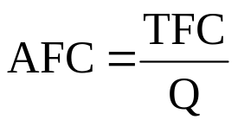
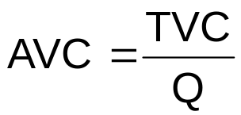
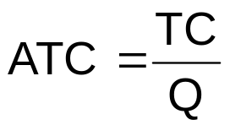
Average Costs
Average fixed cost (AFC)
  Total fixed cost divided by the quantity of output produced
Average variable cost (TVC)
  Total variable cost divided by the quantity of output produced
Average total cost (TC)
  Total cost divided by the quantity of output produced

Slide 42
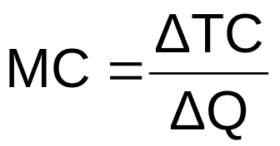
Marginal Cost
Marginal Cost
  Increase in total cost from producing one more unit or output
Marginal cost is the change in total cost (ΔTC) divided by the change in output (ΔQ)
  Tells us how much cost rises per unit increase in output
  The marginal cost for any change in output is equal to the shape of the total cost curve along that interval of the output

Slide 43
Average And Marginal Costs
Rs
MC
4
3
AFC
ATC
2
AVC
1
0
30
90
130
161
196
Units of Output

Slide 44
Explaining the Shape of the Marginal Cost Curve
When the marginal product of labor (MPL) rises, marginal cost (MC) falls
Since MPL ordinarily rises and then falls, MC will do the opposite. it will fall first and then rise
  Thus, the MC curve is U-shaped

Slide 45
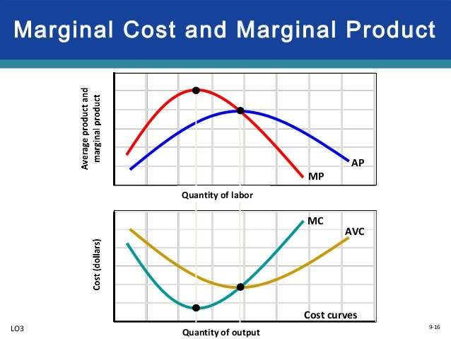

Slide 46
Average And Marginal Costs
At low levels of output, the MC curve lies below the AVC and ATC curves
  These curves will slope downward
At higher levels of output, the MC curve will rise above the AVC and ATC curves
  These curves will slope upward
As output increases; the average curves will first slope downward and then slope upward
  Will have a U-shape
MC curve will intersect the minimum points of the AVC and ATC curves

Slide 47
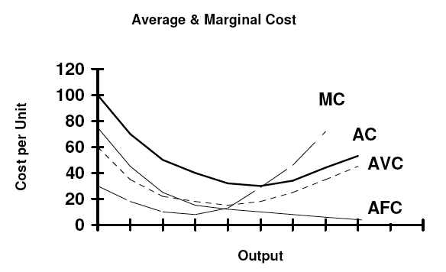
Average and Marginal Costs

Slide 48
Cost Formulas
TC = TFC +TVC
Dividing both sides of the total cost formula by Q, we get the average cost formula:
    TC/Q = TFC/Q + TVC/Q ATC = AFC +AVC
    Average Total Cost = Average Fixed Cost + Average Variable Cost

Slide 49
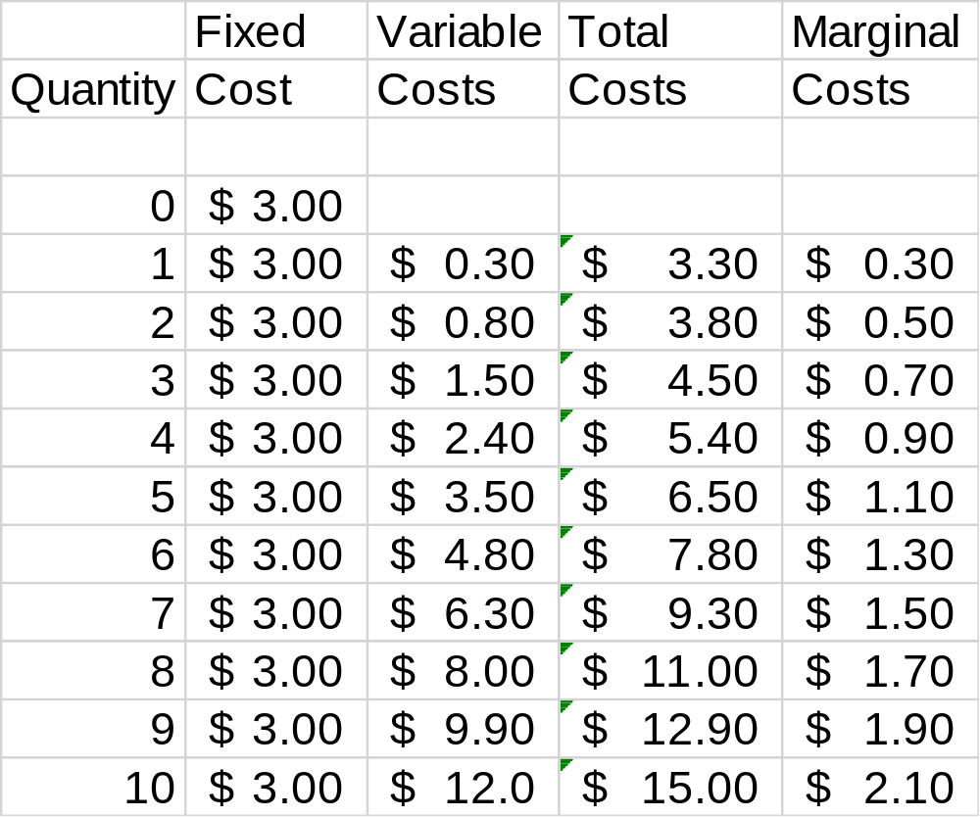

Slide 50
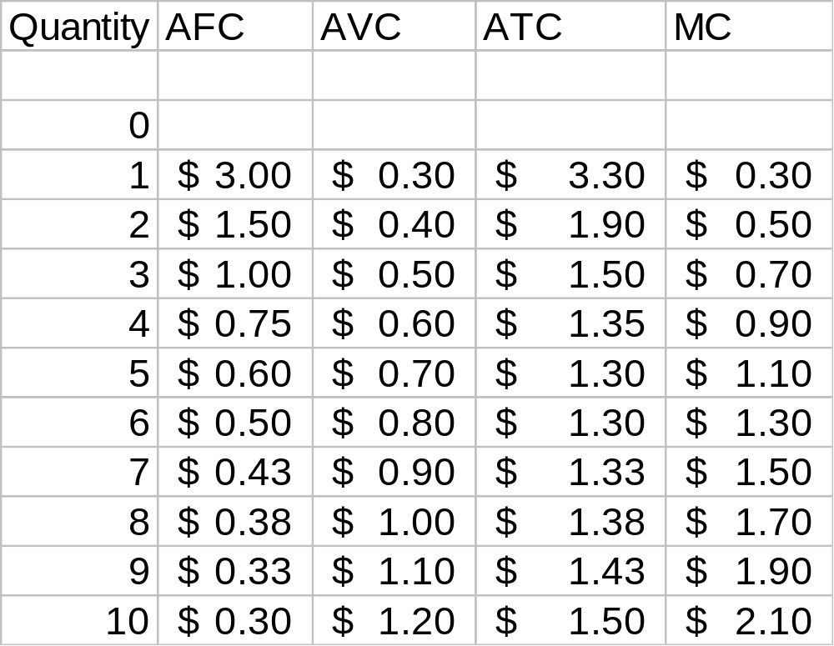

Slide 51
Costs
$3.50
3.25
3.00
2.75
2.50
2.25
MC
2.00
1.75
1.50
ATC
1.25
AVC
1.00
0.75
0.50
0.25
AFC
0
1
2
3
4
5
6
7
8
9
10
Quantity
of Output
(glasses of lemonade per hour)
Copyright © 2004 South-Western

Slide 52
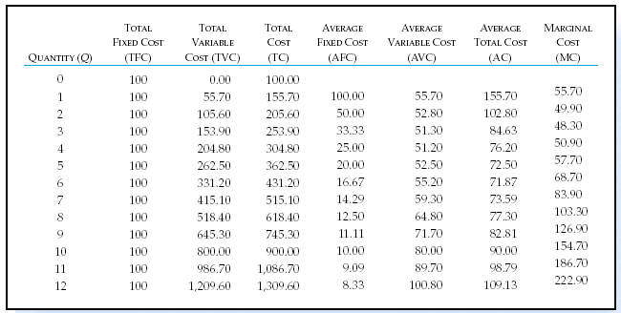
Short-Run Cost

Slide 54
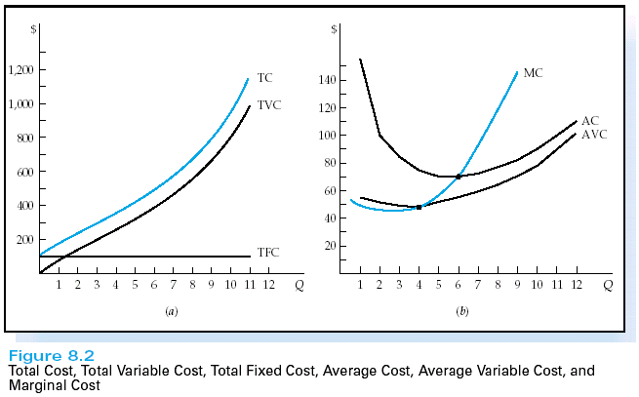

Slide 55
Question 01
Quantity | Total Fixed Cost (TFC) | Total Variable Cost (TVC) | Total Cost (TC) | Marginal Cost (MC) | Average Fixed Cost (AFC) | Average Variable Cost (AVC) | Average Total Cost (ATC)
0 |  |  | 3000
1 |  | 150
2 |  |  |  | 150
3 |  | 540
4 |  |  |  |  |  | 200
5 |  |  |  |  |  |  | 792

Slide 56
Question 02
Quantity | Total Variable Cost (TVC) | Total Fixed Cost (TFC) | Total Cost (TC) | Average Variable Cost (AVC) | Average Fixed Cost (AFC) | Average Total Cost (ATC) | Marginal Cost (MC)
1 |  |  | 600
2 | 190
3 |  |  |  | 90 | 166.67
4 |  | 500 |  |  |  |  | 110
5 |  |  |  |  |  | 200

Slide 57
Production And Cost in the Long Run
In the long run, there are no fixed inputs or fixed costs - All inputs and all costs are variable
The firm’s goal is to earn the highest possible profit
    To do this, it must follow the least-cost rule

Slide 58
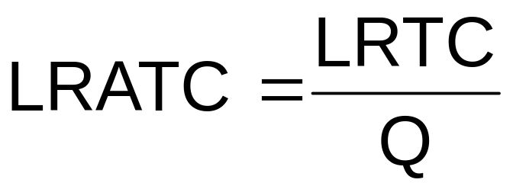
Production And Cost in the Long Run
Long-Run Total Cost
    The cost of producing each quantity of output when the least-cost input mix is chosen in the long run
Long-Run Average Total Cost
    The cost per unit of output in the long run, when all inputs are variable
The long-run average total cost (LRATC)
    Cost per unit of output in the long-run

Slide 59
The Relationship Between Long-Run And Short-Run Costs
For some output levels, LRTC is smaller than TC
The long-run total cost can never be higher than, the short-run total cost
The long-run average cost can never be higher than the short–run average total cost

Slide 60
Average Cost And Plant Size
Plant - Collection of fixed inputs at a firm’s disposal
In the long run, the firm can change the size of its plant
  In the short run, it is stuck with its current plant size
The ATC curve tells us how average cost behaves in the short run when the firm uses a plant of a given size
To produce any level of output, it will always choose that ATC curve among all of the ATC curves available that enables it to produce at the lowest possible average total cost

Slide 61
Graphing the LRATC Curve
A firm’s LRATC curve combines portions of each ATC curve available to the firm in the long run
In the short run, a firm can only move along its current ATC curve
In the long run, it can move from one ATC curve to another by varying the size of its plant

Slide 62
Long-Run Average Total Cost
Rs
ATC₁
LRATC
4.00
ATC₃
ATC₀
ATC₂
3.00
C
D
2.00
B
A
E
1.00
0
30
90
130
161
184
250
300
175
196
Use 0 automated lines
Use 1 automated lines
Use 2 automated lines
Use 3 automated lines
Units of Output

Slide 63
Economies of Scale
Economics of scale
    The long-run average total cost falls as output increases
    When an increase in output causes LRATC to fall, we say that the firm is enjoying increasing economies of scale
    When long-run total cost rises proportionately less than output, production is characterized by decreasing economies of scale
  LRATC curve slopes downward

Slide 64
The Shape of LRATC
Rs
4.00
3.00
LRATC
2.00
1.00
0
130
184
Economies of Scale
Constant Returns to Scale
Diseconomies of Scale
Units of Output

Slide 65
Reasons that Affect the Emergence of Economics of Scale
Technical economies
Managerial economies
Risk- bearing economies
Marketing economies
Financial economies

Slide 66
Reasons that Affect the Emergence of Dis-economics of Scale
Managerial diseconomies of scale
Coordination and control problems
Worker’s alienation
Communication challenges

Slide 67
Thank you

